Slide 1
Build a Strong MERN Foundation
Notes:
Trainer Notes:
This slide is self-explanatory, trainer notes not required.

Slide 2
Online Banking Web Application

Slide 3
Integrating Bootstrap Framework

Slide 4

Before we begin, let’s recall what we have covered till now:​
Bootstrap

Slide 5
Bootstrap
It is a free and open-source CSS framework directed at responsive, mobile-first front-end web development. It contains CSS- and JavaScript-based design templates for typography, forms, buttons, navigation, and other interface components.

Slide 6

Identify the key components and classes provided by the Bootstrap framework
Utilize Bootstrap components to create a layout for a banking website
Assess the design, user experience, and functionality of a banking website built with Bootstrap
Develop a complete banking website using the Bootstrap framework

Slide 7
Task: Implement Bootstrap Integration in the Web Application

Slide 8
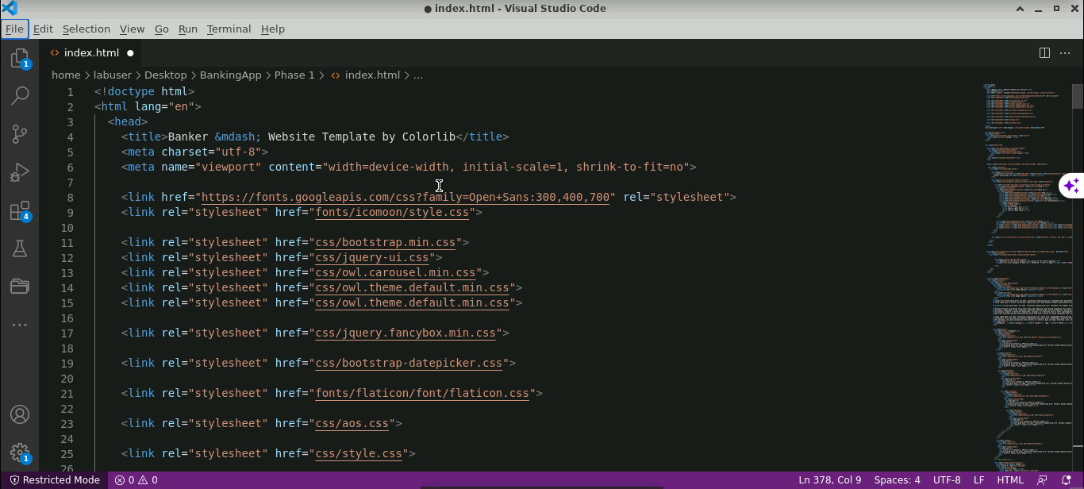
Add Bootstrap Features for the Web Page
Add the Bootstrap CDN link to the head section of the HTML file

Slide 9
Conclusion
By the end of the session, it is expected that:
The Bootstrap classes are properly applied for all the web pages.
The web pages designed should be responsive.

Slide 10
Thank you

